Slide 1
Shock
LHSC Emergency Care Program - 2015
Lucy Vermeulen, 2015

Slide 2
Definition
“A systemic response to a clinical insult
(illness or injury) resulting in inadequate
tissue perfusion and decreased oxygen to
the cells” Holleran, 2007.
Notes:
Kumar and Parrillo (1995) - “The state in which profound and
widespread reduction of effective tissue perfusion leads first to
reversible, and then if prolonged, to irreversible cellular injury.”

Slide 3

“Vital sign changes do not define shock.”
……”evidence of inadequate tissue perfusion
based on physical examination and suspicion based
on history are the best methods of identifying shock.”
Holleran, 2010

Slide 4
Goal
Adequate flow of oxygen to tissues
Notes:
Not to increase blood pressure

Slide 5
Pathophysiology
Lack of oxygen to cells
anaerobic metabolism
Damage to mitochondria
of cells
Accumulation of lactate,
Hydrogen ions &
Phosphates in cells
Dysfunctional electron transport
& cellular destruction
Na shifts into cell;
forcing K outside cell
Swelling in capillary vasculature;
arteriole dilation leading to
uncompensated shock
K changes interfere with
nervous, cardiovascular &
muscular cell function
Holleran, 2010

Slide 6
Immune Response
Release of cytokines and phospholipids
Activation of inflammatory response
SIRS (Systemic Inflammatory Response Syndrome)
Notes:
The cause of shock triggers a systemic inflammatory response

Slide 7
Increased production of glucose
Impaired glucose metabolism
Increased insulin resistance
Coagulopathies (i.e. DIC)
Inc. serum
glucose
Notes:
Glucose metabolism: stress of shock triggers gluconeogensis. The liver and kidneys also produce more glucose in response to catecholamine release.
Even though the body produces more glucose as a response to stress, insulin resistance occurs because of increased production of cytokines.
Increase production of glucose and insulin resistance actually impair cellular growth and metabolism.
Coagulopathies thought to be due to activation of toxins that instigate the cascade system resulting coagulation, resulting in an inability to heal as well as development of DIC.

Slide 8
Impaired oxygen use
Anaerobic metabolism
Increased lactate
Metabolic acidosis
Damaged Na/K pump
Decreased circulatory volume
Notes:
Decreased ATP production results in damage to the mitochondria of the cells which triggers problems with electron transport and onset of cellular destruction.
A shift of sodium into the cell to increase cellular fluid cause the displacement of potassium outside of the cell. When cells swell from the absorption of interstitial fluid, this swelling narrows the capillary lumens and further decreases the supply of oxygen and nutrients to the cells.

Slide 9
Acid-Base Imbalance
Lactate
Base deficit
Low pH
Notes:
Early shock, will get respiratory alkalosis because of inc. resp. rate: the body is trying to inc. oxygen levels and dec. CO2 levels in tissues.
Anaerobic metabolism causes lactate buildup leading to metabolic acidosis
Base deficit is a sensitive indicator for shock.
Consider that lactate levels and base deficit can also be influenced by liver and renal disease.
Hi base deficit and low pH may be an early warning to complications
Metabolic acidosis: correct with adequate ventilation, perfusion, fluids and meds.
ID the cause of shock
If pH is < 7.1 bicarb but ensure adequate ventilation and fluids

Slide 10
Assessment
Heart rate
BP
Neck veins
LOC
Cap refill/skin colour
Urine output
GI
Liver
Notes:
How do we know that tissues are not being perfused?
Resp rate – increased in an effort to dec. CO2 occurring with acidosis (GRADUAL increases may be signs of early shock)
- crackles, coarse breath sounds may be signs of cardiogenic shock
Circulatory – inc HR with sympathetic nervous stimulation responding to dec. CO because of dec. SV. This will be demonstrated in weak pulses
(pediatrics – only way to inc. CO is by HR; eventually this fails….bradycardia…..arrest)
BP – drop in sBP comes from dec. CO or dec venous return.
Early shock- the dBP rises because of sympathetic stimulation on peripheral vascular resistance (vasoconstriction)
PULSE PRESSURE narrows. With shock progression, this sympathetic stimulation becomes less effective so dBP drops.
Neck Veins – flat with dec CO; distended with obstruction
LOC – dec cerebral perfusion are demonstrated by restlessness, anxiety or confusion initially.
Later, obtunded or unconscious
Cap refill – delayed
Urine output – decreased (less than what is considered normal)
GI – hypoperfusion of the GI tract – hypoactive or absent BS
Glucose level - rises b/c of liver’s immobility to mobilize glycogen stores.

Slide 11
History
Immunocompromised
Chemotherapy
Anticoagulants
Beta blockers/pacemakers
Antihypertensives
Steroids
Diabetics
Elderly
Neonates
Notes:
Knowing patient’s hx as best as possible may help identify cause of shock easier

Slide 12
Stages of Shock
Compensated
Uncompensated
Irreversible

Slide 13
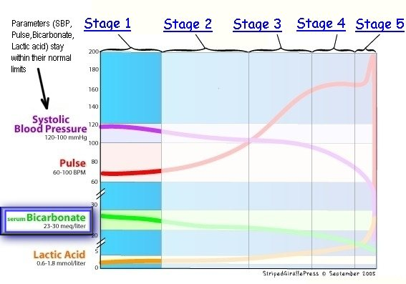
Compensated

Slide 14
Sympathetic nervous system is activated to restore
adequate tissue perfusion particularly to brain and
heart.
Oxygen delivery to non-vital organs is not adequate to
meet cellular demand; thus, anaerobic metabolism
begins
At first this is beneficial as less energy is required
Lactic acid accumulates and begins to cause
cellular damage.
Notes:
Inhibition of baroreceptors by the vasomotor center of the brain in response to decreasing cardiac output results in sympathetic stimulation followed by peripheral vasoconstriction in an effort to increase circulating volume and maintain BP. Similarly the resulting decrease in vagal tone decreases coronary resistance in an attempt to improve myocardial oxygen supply.
Stimulation of the sympathetic nervous system results in release of epinephrine, norepinephrine and other catecholamines that stimulate alpha and beta receptors. This leads to fluid retention by the kidneys. The chronotropic effect is tachycardia.
(Renal hypoperfusion and stimulation of Beta receptors by the sympathetic nervous sytems secondary to shock causes release of renin. This stimulates conversion of
Angiotensinogen to angiotensin I, which is then converted into angiotensin II and causes release of aldosterone and vasoconstriction. Na reasborption is promoted, and water moves into intravascular space which
hopefully increases circulating output. Do get dec in UO.
Beta stimulations has a positive inotropic effect, increasing myocardial contractility and improves coronary blood flow.
The alpha and beta effects promotes venous, return, increasing ventricular filling or preload, heart rate, and myocardial contractility This increases ventricular emptying
and improves cardiac output and BP
Adrenal gland response- gland is stimulated by SNS releasing epinephrine and norepinephrine. This inc heart rate, hopefully improves cardiac output and organ perfusion. This also stimulates the pituitary to release adrenocorticotropic hormone (ACTH) ; this causes the release of cortisol from the adrenal glands. – this elevates the blood sugar and renal retention of water & Na.

Slide 15
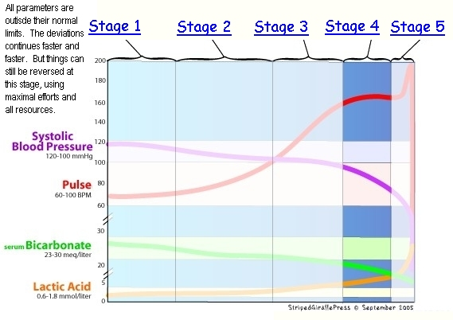
Decompensated

Slide 16
The compensatory mechanisms are unable to
sustain sufficient perfusion to vital organs.
Cellular derangement & death begins
Severe lactate acidemia
Inflammatory/immune system activation
Multiple system failure

Slide 17
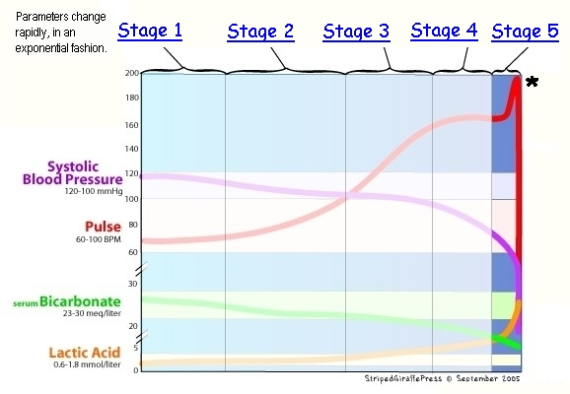
Irreversible

Slide 18
Cellular destruction is irreversible
Specific causes of shock are indistinguishable
Clinical progression is affected by patient’s age,
co-morbidities, severity of hypo-perfusion
Holleran, 2007

Slide 19
Normotensive Shock
If blood pressure is normal, but lactate blood level is high secondary to global tissue ischemia, some call this condition NORMOTENSIVE shock.
Actually, some patients can even be in HYPERTENSIVE shock! ....For example: (a) in cardiogenic or hypovolemic shock with marked sympathetic system activation, (b) during a hypertensive crisis due to pheochromocytoma, or (c) during eclampsia
http://www.stagesofshock.com/microvascular/index.html
Notes:
Think about the patient and his/her condition and co-morbidities

Slide 20
General Treatment
Consider cause & treat
Fluids, blood products
Oxygen
Vasopressors, medications
Monitor very closely (i.e. cardiac, VS, LOC)

Slide 21
Monitor
Critical in the patient with shock
Urine output: >.5mL/kg/hr (Fluid balance is critical)
MAP, heart rate, resp rate, SpO2, temp
LOC
Labs: lactate, blood gas, blood sugar, coag, ‘lytes,
CBC, cardiac markers
Notes:
MAP = [(2 x diastolic)+systolic] / 3
Diastole counts twice as much as systole because 2/3 of the cardiac cycle is spent in diastole. An MAP of about 60 is necessary to perfuse coronary arteries, brain, kidneys. Usual range: 70-110
Monitor for trends: changes can be subtle

Slide 22
Adrenergic Receptor Sites
Adrenergic receptors affected by vasopressors:
Alpha-1adrenergic receptor
Beta-1, Beta-2 adrenergic receptors
Dopamine receptors
Department of Medicine, Univ. of California, n.d.
Notes:
Vasopressors are drugs that elevate Mean Arterial Pressure (MAP) by inducing vasoconstriction.
Alpha-1 adrenergic receptors:
Located in vascular walls and activation induces significant vasoconstriction.
Also present in the heart and can increase the duration of contraction without increased chronotropy (Clinical significance is unclear*)
Beta adrenergic receptors:
Beta-1: In the heart mediates increases in inotropy and chronotropy with minimal vasoconstriction
Beta-2: In blood vessels induces vasodilation.
Dopamine receptors:
In the renal, splanchnic (mesenteric), coronary, and cerebral vascular beds. Induces vasodilation.
A second subtype causes vasoconstriction by inducing norepinephrine release.

Slide 23
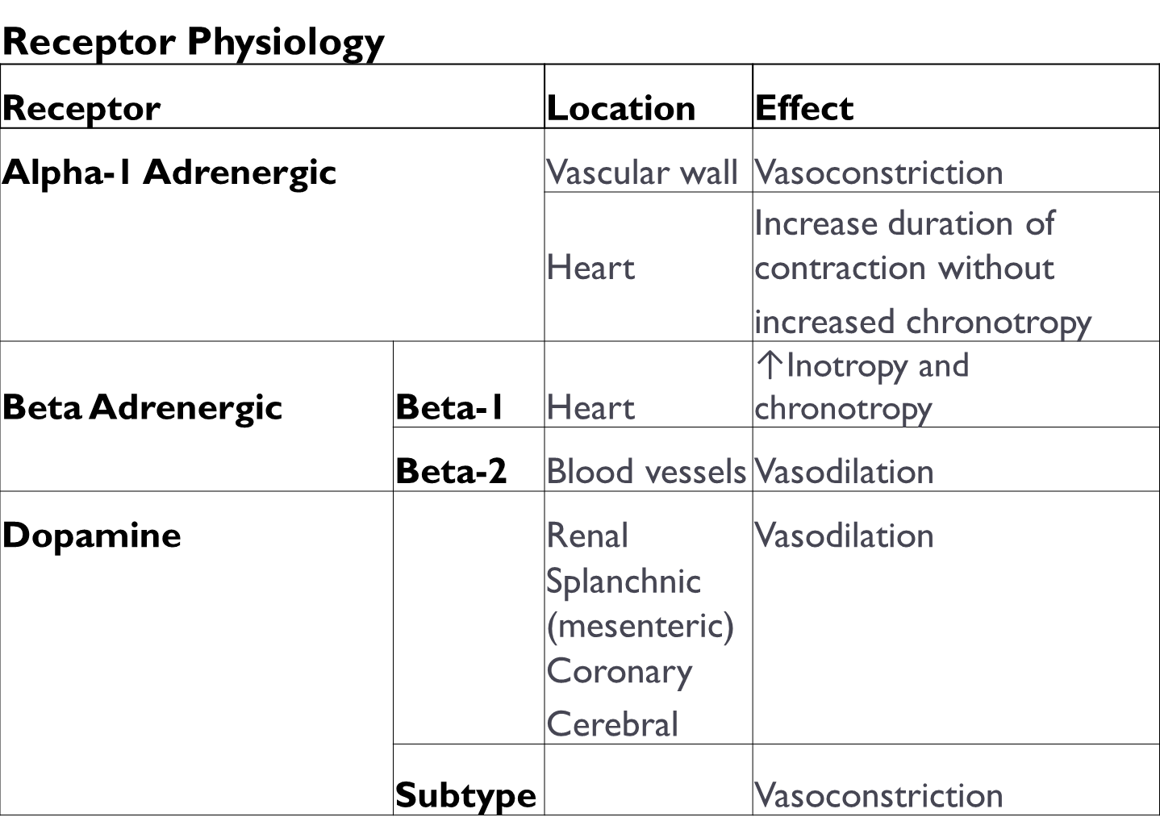
Receptor Sites
Department of Medicine, Univ. of California, n.d.
Notes:
Vasopressors are drugs that elevate MAP by causing vasoconstriction
Inotropes affect cardiac contractility.
Many drugs have both vasopressor and inotropic effects.
Vasopressors are indicated for a decrease of >30 mmHg from baseline systolic blood pressure or MAP <60 mmHg, when either condition results in end-organ dysfunction secondary to hypoperfusion.

Slide 24
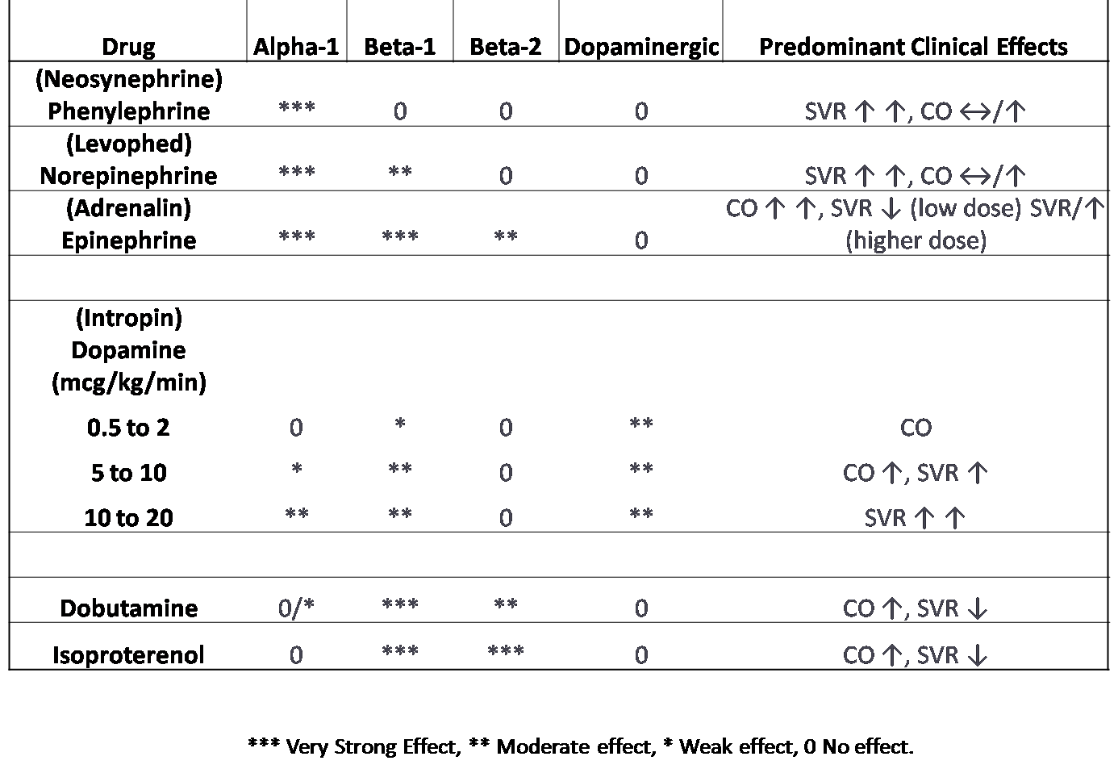
Vasopressors & Receptor Sites
Mount Sinai Emergency Medical Residency, 2013

Slide 25
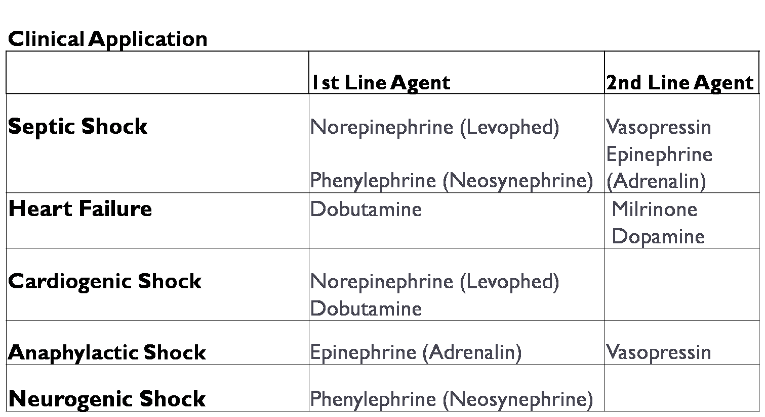
http://www.sinaiem.org/pearls/files/2013/04/Picture2.png
Notes:
Many differences of opinion

Slide 26






Types of Shock

Slide 27
Hypovolemic
“results from loss or redistribution of
blood, plasma, or other body fluids,
which ultimately leads to overall
reduction in intravascular volume.”
Holleran, 2010, p. 448

Slide 28
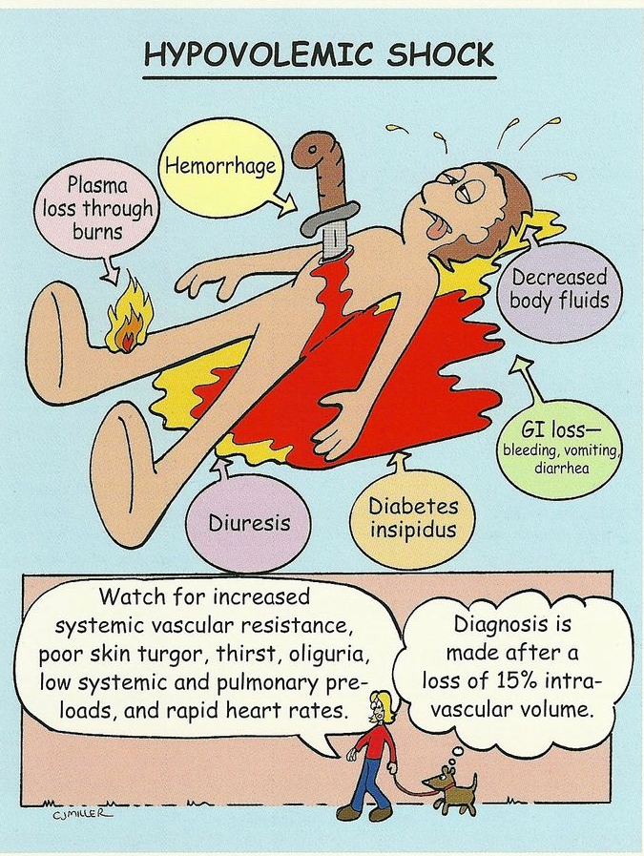
Causes
Hemorrhage
Burns
Vomiting & diarrhea
Notes:
Hemorrhage: multiple trauma, GI bleeds, epistaxis, dissecting aortic aneurysm, vaginal bleeds.

Slide 29
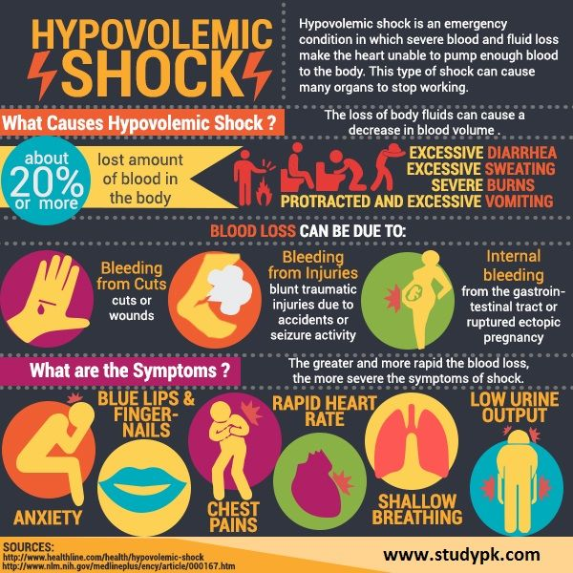

Slide 30
Volume Loss
Decreased venous return
Decreased stroke volume
Decreased cardiac output
Inadequate tissue perfusion & cellular oxygenation

Slide 31
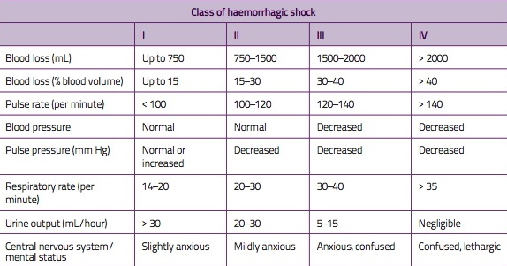

Notes:
. Average Blood Volume: Premature Neonates 95 mL/kg, Full Term Neonates 85 mL/kg, Infants 80 mL/kg, Adult Men 75 mL/kg, Adult Women 65 mL/kg. Desired urine output for neos is 2mL/kg/hr; children is 1 mL/kg/hr; adults 0.5mL/kg/hr

Slide 32
Treatment for Hypovolemic Shock
Maintain airway & breathing
Oxygen
Control any external bleeding
2 large bore IVs (minimum 18 g) into large veins
(antecubital fossa)
Normal saline, LR, blood products
Close monitoring of output (minimum q1h)
ECG/BP/SpO2 monitoring
Vasopressors only after fluid resuscitation
Notes:
Treatment should be based on patient’s response not on monitor numbers

Slide 33
Treatment
LR is globally accepted as 1st choice
(warmed, 1-2L)
Blood volume replacement
Type specific & cross-matched
Type-specific
Type O-negative
Type O-positive
FFP, cryoprecipitate, PLTs, TXA
Warmed fluids
Monitor output****
Monitor vitals, LOC
Emergency Nurses Association, 2007
Notes:
LR rather than NS because it is a near physiologic solution similar to extracellular fluid. NS is 2nd choice (1-2 L bolus warmed solution)
Type-specific and cross matched is ideal
Type-specific blood usually available within minutes
O negative is universal donor; Rh-negative blood has not Type D antigen; can be difficult to obtain
O positive are used for males, females >55 because the risk of their plasma having anti-D antibodies is remote.
FFP: contains all clotting factors (must be ABO compatible)
Platelets – need not be ABO compatible; can’t run thru rapid infuser
Cyroprecipitate – used with repeated febrile reaction; reaction from leukocyte antibodies and patients who are candidates for organ transplants
TXA – prevents fibrinolysis
The body responds to heat loss by shivering, which increases oxygen consumption in skeletal muscles by 40% to 400%. This high metabolic demand places some organs at risk of developing ischemia. Hypothermia interferes with the clotting mechanisms of the blood by disrupting platelet function, slowing the chemical reactions that ultimately produce the protein strands necessary to build blood clots and by suppressing the immune system. A drop in body temperature of 1 degree Celsius results in a 6% to 7% decrease in cerebral blood flow, which could be dangerous for patients with traumatic brain injury.

Slide 34
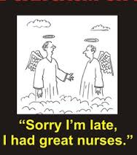
Hypovolemic shock
is one of the most
common causes of
PEA arrest

Slide 35
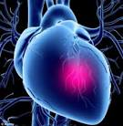
Cardiogenic
The heart fails as a pump
causing “end-organ
hypo-perfusion”
Reynolds & Hochman, 2008
Notes:
The leading cause of death in acute MI
The overall in-hospital mortality rate for patients with cardiogenic shock is 57% (Ren, Lenneman & Loi 2014)

Slide 36
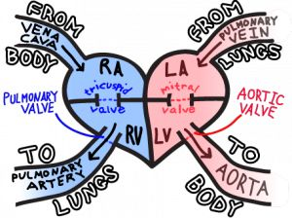

Slide 37
Causes
MI
Valvular disease
Any cause of acute severe LV
or RV dysfunction
Notes:
MI with LV failure is the most common cause of cardiogenic shock – will see it with damage from MI to >40% of LV (usually Left main or LAD)
CS continues to complicate approximately 5% to 8% of STEMI and 2.5% of non-STEMI cases
The only way to prevent CS appears to be very early reperfusion therapy for MI
Careful use of beta blockers and ACE inhibitors in these patients is essential to avoid hypotension leading to cardiogenic shock
Risk factors for development of CS in the context of MI: older age, anterior MI, hypertension, diabetes mellitus, multivessel coronary artery disease, prior MI or angina, prior diagnosis of heart failure, STEMI, and left bundle-branch block. There may be clues to impending shock: Heart rate is higher and blood pressure lower on hospital presentation among patients who develop CS after admission

Slide 38
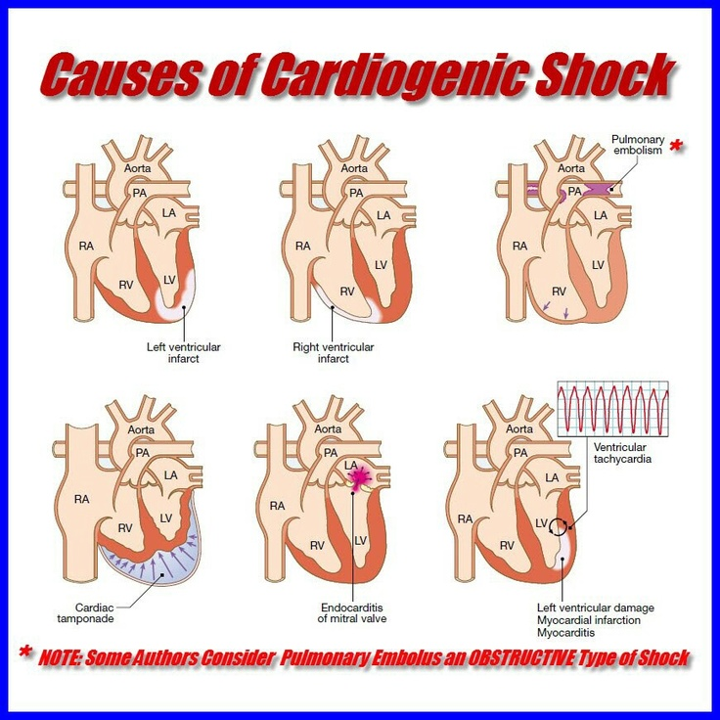

Slide 39
Pump failure
Inability to eject blood
Decreased stroke volume
Decreased CO and BP
Notes:
Dec. tissue perfusion may precipitate further myocardial ischemia worsening cardiac contractility. This

Slide 40
Altered tissue perfusion
Worsening myocardial ischemia/injury
Worsening cardiac contractility
Incomplete LV emptying

Slide 41
Incomplete LV emptying
Causes inc pressures in
LV, LA, pulmonary pressures
Pulmonary capillaries leak
Fluid in alveolar spaces causing pulmonary edema
Increased RV and
Atrial pressures,
leading to R failure
Eventual cardiovascular collapse
Notes:
Mortality rates associated with CS

Slide 42
Symptoms
Cold extremities
Increased JVD
Increased afterload
Pulmonary congestion
Distant heart sounds
Tachycardia, tachyarrhythmias
Altered LOC

Slide 43
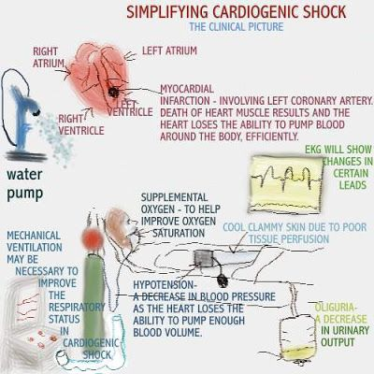
Notes:
ECG: may or may not have ST elevation

Slide 44
Treatment
Positive inotropes
Vasopressors in lowest possible dose
Perfusion therapy (PCI)
CABG
Notes:
Inotropes: to increase myocardial contractility – but inotropes also increase myocardial oxygen demand when heart is already failing
(Epinephrine, Dopamine 5-10 mcg/kg/min to start but may need up to 20
If BP > 80 may choose dobutamine instead because it has less effect on myocardial oxygen demand. (but can cause hypotension)
Milrinone: inotropes with vasodilating properties, (would likely require vasopressor support)
Higher vasopressors are associated with poorer survival rates
recommend norepinephrine for more severe hypotension because of its high potency.
Although both dopamine and norepinephrine have inotropic properties, dobutamine is often needed in addition
Dopamine has traditionally been the drug of choice, owing to its vasopressor and inotropic activity. Norepinephrine
was preferred over dopamine in patients with more severe hypotension due to its more potent
vasoconstriction. However, recent literature showing a potential increase in mortality with dopamine over
norepinephrine has questioned the use of dopamine as a first line agent in cardiogenic shock. Both
dopamine and norepinephrine can cause increased myocardial oxygen demand and may aggravate
ischemia. This can lead to arrhythmias
For patients who are in a low output cardiogenic shock dobutamine may be
added to optimize cardiac output (CO). However, dobutamine can cause vasodilation (dobutamine is mostly beta 1); therefore, its use
should be in patients with less severe hypotension or in combination with a vasopressor to improve
cardiac output (CO) in severe hypotension
Mechanical support: Intra aortic balloon counterpulsation

Slide 45
Obstructive
“inadequate circulating blood volume
because of an obstruction or compression
of a vessel or vessels.”
Halloran, 2007, p. 735
Notes:
Vessels that are around heart;

Slide 46
Causes
Pulmonary embolus
Aortic dissection
Tension pneumothorax
Intrathoracic tumours
Pericardial tamponade
Notes:
Air can obstruct the pulmonary artery and cause an obstruction to right ventricular outflow during systole with resulting shock.
Blood in the pericardial sac can compress the heart – it may take < 100 mL of blood accumulation in the pericardial sac to produce significant symptoms. More commonly seen in penetrating injuries of the thorax.
Prevents filling of the atria and ventricles leading to decreased stroke volume.
PE prevents right ventricular emptying when the pulmonary artery is obstructed. This causes decreased cardiac output

Slide 47
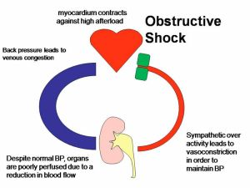
Notes:
Obstruction causing increased afterload or decreased preload
PE
Pericardial tamponade
Tension pneumo
Obstruction of the great vessels

Slide 48
Symptoms
Bradycardia, tachycardia
Altered LOC
Hypotension
Restlessness
Hypoxia
Distended neck veins
Abnormal heart sounds
Cool extremities
Pallor, clamminess

Slide 49
Risk Factors
Immobility
Clotting disorders
Severe chest injuries
Plaque

Slide 50
Treatment
Maintaining oxygen support
Hemodynamic support
Reversal of organ injury
Pericardiocentesis
Needle thoracotomy/ chest tube
Heparin
Pulmonary embolectomy, tpa
Notes:
Outflow problems - PE, Aortic coarctation, Aortic
stenosis, pulmonary HTN
- Judicious fluids
- Inotropes or mixed inotrope/vasoconstrictor - dobutamine, norepinephrine
Inflow problems - Cardiac tamponade, pneumothorax
- Fluids
- Relieve source (pericardiocentesis, chest tube)
ventilation, hemoglobin (100) , oxygen saturation (>92)
MAP > 60 (mixed inotrope/vasoconstrictor: Dobutamine, Norepi)
Ensuring adequate Urine output, treating acidosis, renal & liver function monitoring and treatment prn

Slide 51
Distributive
“distributive shock occurs because of either a
mal-distribution of volume resulting from vasodilation
or a loss of autonomic sympathetic functions.”
Halloran, 2007 p. 732
Defining feature: loss of peripheral resistance
Society of Critical Care Medicine, n.d.
Notes:
caused by loss of vasomotor control resulting in
arteriolar/venular dilatation and characterized (after fluid resuscitation)
by increased cardiac output and decreased SVR
Vasopressors play the biggest role in distributive shock
Leaky pipes
MAP < 50 – problem with cerebral blood flow and resulting injury
MAP of 65 for adequate diastolic filling
MAP 65-70 renal perfusion

Slide 52
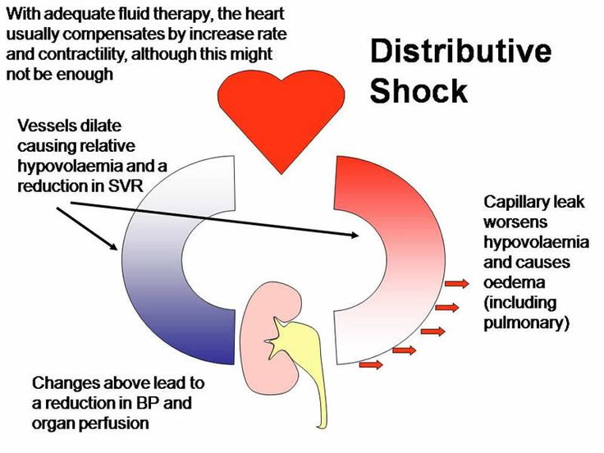

Slide 53
Sub-types
Neurogenic
Anaphylactic
Septic
Notes:
Leaky pipes

Slide 54
Septic
“sepsis-induced hypotension persisting despite adequate fluid resuscitation”
Dellinger et al., 2012
Notes:
Most common cause of shock overall. Bacterial is most common cause of septic cause.
Sepsis is defined as the presence of infection in association with SIRS, that is, a systemic immune response caused by an infection
Severe sepsis is defined as sepsis that is complicated by end-organ dysfunction, as signaled by altered mental status, an episode of hypotension, elevated creatinine concentration, or evidence of DIC.
Septic shock is defined as a state of acute circulatory failure characterized by persistent arterial hypotension despite adequate fluid resuscitation or by tissue hypoperfusion (manifested by a lactate concentration >4 mg/dL) that is unexplained by other causes. Patients receiving inotropic or vasopressor agents may not be hypotensive by the time that they manifest hypoperfusion abnormalities or organ dysfunction.
(Kalil, 2014)
Mortality rate associated with septic shock is 50%
The presence of infection associated with a systemic inflammatory response that results in physiologic alterations at the capillary endothelial level.

Slide 55
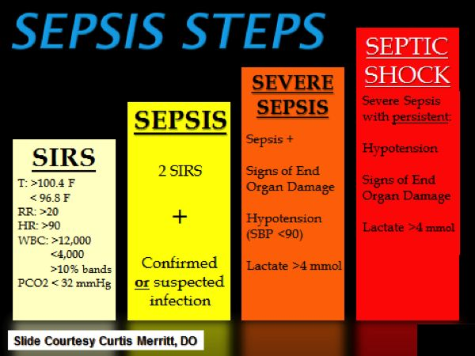
Notes:
SIRS – altered LOC, inc temp, inc RR, inc HR, dec BP – sign of shock

Slide 56
Pathology
Localized infection
Activation of host defense mechanisms
Influx of neutrophils, monocytes & inflammatory mediators
Capillary vasodilation, increased vascular permeability, activation of coagulation pathway
Kalil, 2014)
Notes:
This cascade leads to thrombosis of end-organ capillaries affecting perfusion
The coagulation factors are activated as a result of endothelial damage
The imbalance among inflammation, coagulation, and fibrinolysis results in widespread coagulopathy and microvascular thrombosis and suppressed fibrinolysis, ultimately leading to multiple organ dysfunction and death
The predominant hemodynamic feature of septic shock is arterial vasodilation (multiple reasons).
vasodilation results in hypotension and shock if insufficiently compensated by a rise in cardiac output (cardiac output is often increased to maintain blood pressure in the presence of systemic vasodilatation).
When intravascular volume is augmented, the cardiac output usually is elevated

Slide 57
Symptoms
SIRS criteria
Infection
Refractory hypotension
(<90 sBP, MAP <65)
Serum lactate > 4
Notes:
Elderly patients are more susceptible to sepsis, have less physiologic reserve to tolerate the insult from infection, and are more likely to have underlying diseases, all of which adversely impact survival. In addition, elderly patients are more likely to have atypical or nonspecific presentations when septic.
Sepsis and septic shock in the immunocompromised patient is associated with a wide variety of bacteria and fungi.
Most frequent sites of infection: Lungs, abdomen, and urinary tract. Other sources include the skin/soft tissue and the CNS.

Slide 58
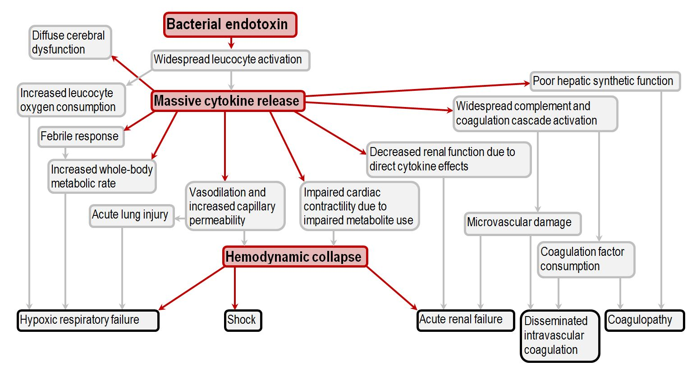
Notes:
Hypoxic respiratory failure
There is an increase in whole-body oxygen consumption, due to massive leuckocyte activation as well as the increased metabolic rate of critical illness, as well as the increased metabolic rate associated with hyperthermia.
Not only that, but there may be a diffusion defect as the capillaries of the pulmonary circulation become leaky, and ARDS develops.
Hemodynamic collapse
The defining feature of septic shock, systemic vasodilation due to inflammatory mediators, results in decreased oxygen delivery to the whole body, exacerbating the dysfunction of the organs.
Septic cardiomyopathy
Thought to be due to impaired metabolite utilisation at a mitochondrial level, the cardiac dysfunction in sepsis results in biventricular failure.
Acute renal failure
As a result of decreased cardiac output, the renal function deteriorates, and oliguric renal failure becomes established. Not only that, but there is tubular dysfunction caused by the inflammatry cytokines, which is unrelated to the hypotension.
Hepatic dysfunction
Though the liver may not fail per se, there is typically a sepsis-associated rise in transaminases and bilirubin. Furthermore, the synthetic function is impaired, which contributes to the ensuing hypoalbuminaemia and coagulopathy.
Septic encephalopathy
Through mechanisms still poorly understood, severe sepsis results in a diffuse cereberal dysfunction which seems to worsen the prognosis. Cytokines, microvascular damage and impaired mitochondrial oxygen utilization have all been implicated.
Coagulopathy
Even in the absence of proper DIC, there is usually some degree of subclinical coagulopathy. There is simultaneously a depletion of coagulation factors and a decrease in their hepatic production.

Slide 59
Treatment
Early recognition
IV fluids – aggressive Rx
Antibiotics within one hour
Monitor organ perfusion: vital signs, urine output, LOC

Slide 60
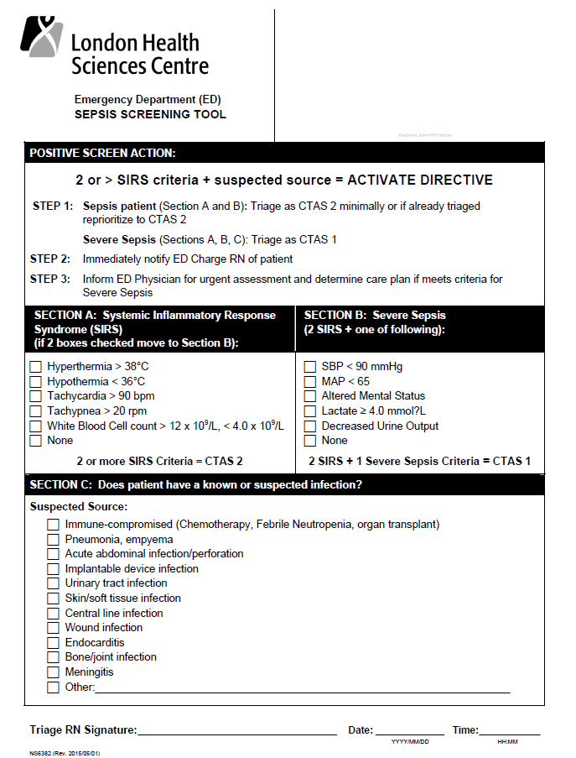

Slide 61
Vasopressors
Indicated with refractory hypotension
Target MAP 65
Norepinephrine is considered first choice
Epinephrine is next best choice
PulmCCM, 2013
Notes:
Norepinephrine increases mean arterial pressure primarily through vasoconstriction, with little effect on heart rate, stroke volume, and cardiac output; dopamine increases MAP primarily through an increase in cardiac output (by increasing both heart rate and stroke volume). These characteristics make dopamine more likely to cause harmful tachyarrhythmias.
Epinephrine may increase lactate concentrations by stimulating skeletal muscles' aerobic metabolism, thereby interfering with the use of lactate as a marker of perfusion during treatment of septic shock.
Dopamine brings inc. risk for death compared to norepi. Can be used if have really low heart rates or are considered to be very low risk for tachyarrhhythymias
In one study, vasopressin carried an increased risk of death compared to epi
Phenyl can dec. stroke volume
Dobutamine can be used with low cardiac output with high filling pressures while on vasopressors, or who have persistent evidence of hypoperfusion after attaining an adequate mean arterial pressure

Slide 62
Neurogenic
“results from an imbalance between the
sympathetic and parasympathetic
stimulation of the vascular smooth muscle.”
Halloran, 2007 p. 732
Notes:
Leads to a loss of peripheral resistance
The diagnosis of neurogenic shock should be one of exclusion. Neurogenic shock must be differentiated from other types of shock, particularly hypovolemic. When dealing with a trauma patient, one must always assume that any hypotension is a result of ongoing blood loss

Slide 63
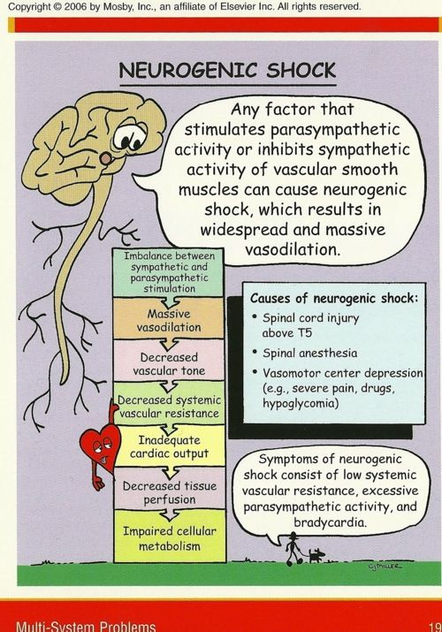
Medulla is inhibited
Dec. sympathetic regulation
of vasculature
Loss of sympathetic tone:
vasodilation & bradycardia
Decreased venous return,
decreased cardiac output,
hypotension
Dec. tissue perfusion
Notes:
Normally, stress leads to sympathetic stimulations and an inc in HR and BP. In neurogenic shock, the sympathetic nervous system is not able to respond to stressors. Parasympathetic influence with present pt with dry warm skin, hypotension, bradycardia.
The most damaging effect of this condition is shunting of oxygen rich
blood away from tissues surrounding the primary injury
site, which are at greatest risk of secondary injury.
The cardiac output decreases because the venule and small veins lose tone. Blood pools in the periphery and blood pressure falls. In the normal situation, a reflex increase in heart rate will occur to compensate for the peripheral pooling of blood. However, in neurogenic shock, the sympathetic pathways to the heart are blocked or damaged by trauma, resulting in a bradycardia.

Slide 64
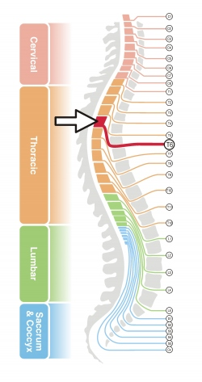
Causes
Injury to CNS (T6 or higher) or
damage to brain (vasomotor centre)
Intense emotional trauma/stress
causing sudden loss of ANS
control
Vagus nerve stimulation
Notes:
Injuries above the T1 level have the capability of disrupting the spinal cord tracts that control the entire sympathetic system. Injuries occurring in the levels from T1 to L3 may only partially interrupt the sympathetic outflow. The higher the level of injury the more likely it is for the patient to exhibit severe symptoms
Vagus nerve stimulation leads to syncope (Brief and self limiting neurogenic shock)

Slide 65
Symptoms
Hypotension
Bradycardia
Flaccid paralysis below injury level
Hypothermia or warm dry skin from vasodilation
Absence of jugular vein distention
Acidosis
Altered mental status
Diminished or absent bowel sounds (shunting)

Slide 66
Treatment
“restore adequate oxygenation to vital
tissues and limit cellular damage” (King & Olson, 2007)
Close cardiac monitoring, FP
Fluid status monitoring (incl. output; assess for
possible bladder distention)
Slow warming if hypothermic
IV fluids
Pacing
Notes:
Treat cause of shock
All other shocks must be ruled out first (i.e hypovolemic shock)
Limit the effects of hypotension and bradycardia on the rate of secondary neurologic injury
Warming too rapidly may make pt more hemodynamically compromised
Due to the physiologic nature of neurogenic shock, vasopressors may be initiated earlier to avoid volume overload. Vasopressors to reach MAP of 85-90 to help perfuse the periphery of the injured area and thus limit the amount of secondary neurologic injury.
Vasopressor of choice: some literature say vasopressin (pure alpha); others say norepi (alpha & beta); some say phenylephrine

Slide 67
Anaphylactic
An extreme, life-threatening allergic reaction to an antigen to which the body has become hypersensitive

Slide 68
Pathophysiology
exposure to allergen
Profound reduction in venous tone
& extravasation of fluids
Reduced venous return
Decreased output
Halloran, 2010

Slide 69
Symptoms
Airway tightness
SOB
Skin flushing
Hypotension
Tachycardia
Hives/urticaria
Nausea/vomiting/diarrhea
Notes:
Fairly sudden onset

Slide 70
Treatment
Airway, breathing, circulation
Epinephrine
Antihistamines
Steroids
Bronchodilators
Epi infusion
Notes:
Vasopressor – epinephrine is used to inc. cardiac output with its Beta 1 effect on the heart
Epinephrine works by stimulating the release of both beta-1 and beta-2 neurotransmitters
Through vasoconstriction, it decreases edema, thereby preventing and relieving upper airway obstruction and increases blood pressure, thereby preventing and relieving shock. Its beta-1 adrenergic effects lead to increased rate and force of cardiac contractions. Its beta-2 effects lead to increased bronchodilation and decreased release of histamine

Slide 71
Case Scenarios
Common ED Shock Presentations

Slide 72
A 25 year old female presents via EMS with
decreased LOC, BP 80/58, RR 24, T 36.0 SpO2 94,
HR 122. No past medical history; woke up with
abdominal pain this morning.
Notes:
Describe assessment: ABCD included with EMS, but needs to be repeated
Vital signs essentially unchanged with repetition
Needs 2 large bore IVs in antecubital
Blood products to be considered
FAST machine shows blood
Pregnancy test comes back positive

Slide 73
A 46 year old man presents with chills, feeling
unwell today. Vitals at triage are: T 37.5, HR 89,
RR 20, BP 118/76.
Past history: lung CA, on chemo
Notes:
Sepsis protocols
What labs do we expect to be altered? Lactate, metabolic acidosis, WBC is probably low (ANCs)
His pressure drops to 76/56: he’s had 3 liters of fluid. What pressors can we anticipate?

Slide 74
An 18 year old man presents to ED, involved in
MVC rollover; dec. LOC, very restless;
HR 150 BP 86/56, RR 28.
Notes:
Absent breath sounds on R. Respiratory status increasingly compromised. Tension pneumothorax

Slide 75
A 24 year old woman presents to ED with
suspected neck injury after MVC. Was unbelted.
HR 106 RR 20 BP 96/60 SpO2 94% RA
Notes:
Assessment reveals abd pain – blood in abdomen. In hemorrhagic shock. Differentiated from neurogenic shock – is tachy not brady.
Neurogenic shock is diagnosed by exception

Slide 76
A 76 year old woman presents to the ED with
decreased LOC, SOB.
History of CAD. Vital signs: HR 124, RR 28 BP 84/64
SpO2 92% RA, afebrile
Notes:
ECG – shows elevation in v3 and v4
JVD is up
Crackles in lungs
Cold extremities
What pressor should we use?

Slide 77
References
Dellinger, R.P. et al. (2013). Surviving Sepsis Campaign: International
Guidelines for Management of Severe Sepsis and Septic Shock 2012
Retrieved April 13, 2015 from
http://www.idsociety.org/uploadedfiles/idsa/guidelines-
patient_care/idsa_practice_guidelines/fever_and_infections/2013%20sepsis%20guidelines.pdf
Department of Medicine, University of California, Irvine (n.d.) Vasopressors and Inotropic Agents. Retrieved
April 14, 2015 from https://www.google.ca/url?url=https://www.medicine.uci
edu/residency/powerpoint/VasopressorsandInotropes.ppt&rct=j&frm=1&q=&esrc=s&sa=U&ei=
11ktVZ2HN5L9yQSn8YH4Aw&ved=0CCUQFjAD&usg=AFQjCNHZ0_nFjCt-wwLCrct0mTtXTmx2BA
Emergency Nurses Association (2007). Trauma Nursing Core Course, Provider Manual, 6th ed. Des Plaines, IL:
Emergency Nurses Association.
Holleran, R. S. (2007). Shock Emergencies. In Emergency Nursing Core Curriculum, 6th ed. (Hoyt & Selfridge-
Thomas, eds.) Missouri: Saunders Elsevier
Kalil, A. (2014). Septic Shock. Retrieved April 13, 2015 from http://emedicine.medscape.com/article/168402-
overview#aw2aab6b2b2

Slide 78
References
King, K. & Olson, D. (2007). What you should know about neurogenic shock. American Nurse Today. Retrieved
April 13, 2015 from
https://www.americannursetoday.com/assets/0/434/436/440/4172/4174/4208/4210/256f41df-38e7-4bb1-
9771-a4c73f49102a.pdf
Mount Sinai Emergency Medical Residency (2013). Vasopressors and Inotropes in the Critically Ill Patient.
Retrieved April 14, 2015 from http://www.sinaiem.org/pearls/2013/04/04/sinai-empearl-4413/
PulmCCM (2013). Surviving Sepsis Guidelines 2013 – Review & Update. Retrieved April 14, 2015 from
http://pulmccm.org/2013/review-articles/surviving-sepsis-guidelines-2013-review-update/
Ren, X., Lenneman, A. & Ooi, H. (2014). Cardiogenic Shock Treatment and Management. Medscape. Retrieved
April 9, 2015 from http://emedicine.medscape.com/article/152191-overview
Reynolds, H.R. & Hochman, J. S. (2008). Contemporary Reviews in Cardiac Medicine. Cardiogenic Shock:
Current Concepts and Improving Outcomes. Circulation (117), p. 686-697.
10.1161/CIRCULATIONAHA.106.613596
Society of Critical Care Medicine (n.d.). Shock, Pathophysiology, Classification and Approach to Management.
Retrieved on April 13, 2015 from
http://www.uphs.upenn.edu/surgery/Education/trauma/SCCS/curriculum/Shock.pdf

